Slide 1
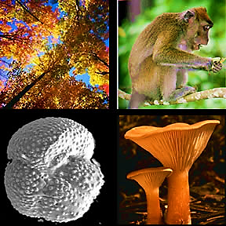
Cell Biology Lec (3)
Eukaryote

Slide 2

What do trees, monkeys, plankton and mushrooms have in common?
They are all members of the Eukaryote domain! You are a member of the Eukaryote domain too!
Plants, animals, protests and fungi, are all members of the domain. All members of the domain Eukaryote have eukaryotic cells. Eukaryotic cells have three main components: cell membrane, nucleus and variety of other organelles.

Slide 3

The cell membrane: is a complex barrier separating every cell from its external environment, regulates what passes into and out of the cell.
The nucleus:
1- The largest organelle in a Eukaryotic cell.
2-The nucleus contains the cell’s chromosomes (human 46, fruit fly 6), which contain both linear DNA and proteins known as histones.

Slide 4
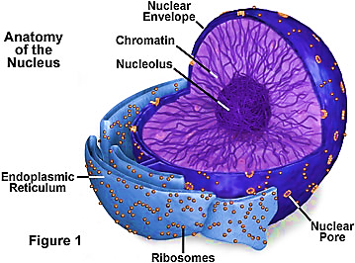
3- Most cells have a single nucleus, some cells have more than one (fungi have many nuclei in their cytoplasm).
4- A double membrane called the nuclear envelope surrounds the nucleus. Which has many nuclear pore by which mRNA and proteins can pass.
5- Most nuclei contain at least nucleolus (nucleoli), where ribosomes are synthesised (ribosomes translate mRNA into proteins).

Slide 5

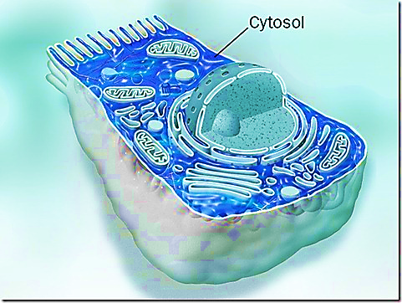
Cytoplasm
1- Everything within the cell membrane, which is not the nucleus, is known as the cytoplasm.
2- Cytosol is the jelly-like mixture in which the other organelles are suspended, so cytosol + organelles = cytoplasm.

Slide 6

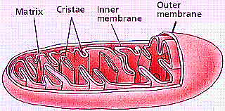
Mitochondria
1- Found scattered throughout the cytosol.
2- Mitochondria are the sites of aerobic respiration, in which energy from organic compounds is transferred to ATP (ATP is the molecule that most cells use as their main energy). For this reason, they are sometimes referred to as the powerhouse.

Slide 7
Mitochondria
3- Mitochondria are surrounded by two membranes:
a. The smooth outer membrane serves as a boundary between the mitochondria and cytosol.
b. The inner membrane has many long folds, known as cristae.

Slide 8
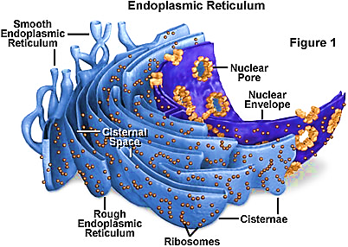
Endoplasmic reticulum (ER)
1- The ER is a system of membranous tubules and sacs.
2- The primary function of the ER is to act as an internal transport system, allowing molecules to move from one part of the cell to another.

Slide 9
Endoplasmic reticulum (ER)
3- The number of ER inside a cell depending on the cell’s activity.
4-There are two types of ER:
a. Rough ER.
b. Smooth ER, where polypeptide are converted into functional proteins.

Slide 10
Ribosomes
1- Ribosomes are not surrounded by a membrane.
2- Ribosomes are the site of protein synthesis in a cell.
3- Line the membranes of Rough endoplasmic reticulum (rough ER).
4- They exist in two sizes:
a. 70s are found in all prokaryotes.
b. 80s found in all eukaryotic cells.

Slide 11
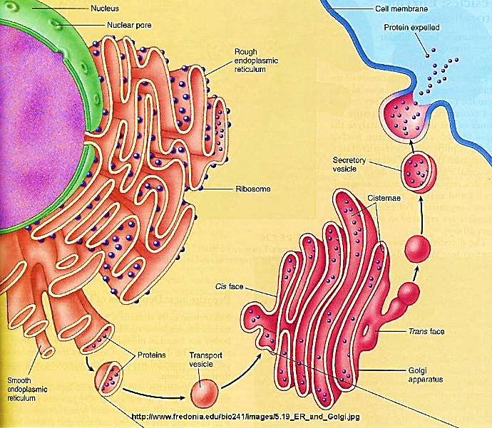
Golgi apparatus
1- The Golgi apparatus is a system of membrane, made of flattened sac-like structures.
2- It works closely with the ER to modify proteins for export by the cell.

Slide 12
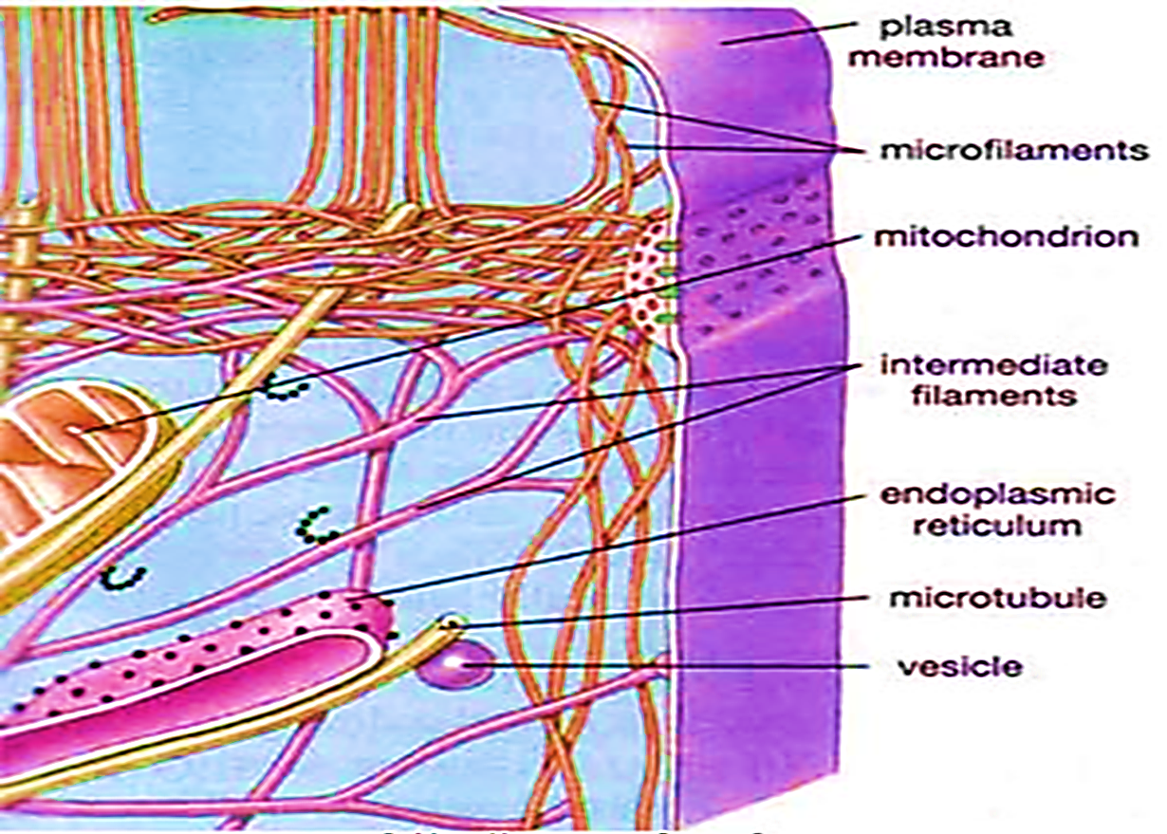
Cytoskeleton
1- Just as your body depends on your skeleton to maintain its shape and size, so a cell needs structures to maintain its shape and size.
2- In animal cells, which have no cell wall as in plant cell, cytoskeleton maintains the shape of the cell, and helps the cell to move.

Slide 13
Cytoskeleton
3- The cytoskeleton consists of two structures:
a. Microfilaments, made of actin they are common in motile cells.
b. Microtubules, made of tubulin, they form the centriole.

Slide 14
Multicellular organization
In most multicellular organisms, we find the following organization:
1- Cellular level: the smallest unit of life capable of carrying out all the function of living things.
2- Tissue level: a group of cells that performs a specific function in an organism.
3- Organ level: several different types of tissue that function together for a specific purpose.
4- Organ system level: several organs working together to perform function. The different organ system in a multicellular organism interact to carry out the processes of life.
5- Plants have four organs they are: roots, stems, leaves and flowers.

Slide 15
